Slide 1
Unit II- Topic :Data Transformation with dplyr Sub Topic: Introduction
Visualization is an important tool for insight generation
Data transformation is to make the data a little easier to work with using the dplyr package
A new dataset on flights departing New York City in 2013
library(nycflights13)
library(tidyverse)

Slide 2
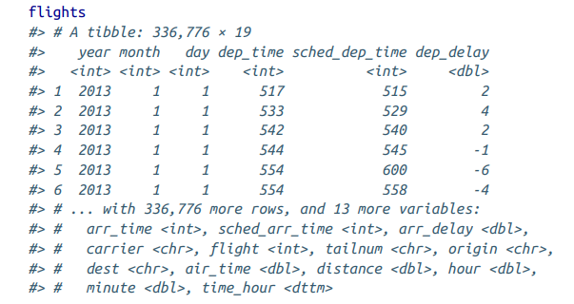
Flights dataset- nycflyights13::flights
To explore the basic data manipulation verbs of dplyr, we’ll use nycflights13::flights.
This data frame contains all 336,776 flights that departed from New York City in 2013.
The data comes from the US Bureau of Transportation Statistics and is documented in ?flights:
?flights
Tibbles are data frames, but slightly tweaked to work better in the tidyverse which will cover in Unit III

Slide 3
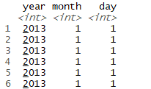
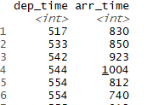
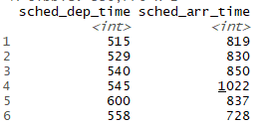
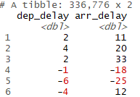
Flights dataset- nycflyights13::flights
19 Variables as follows:
year, month, day---Date of departure.
dep_time, arr_time ---Actual departure and arrival times (format HHMM or HMM), local tz.
sched_dep_time, sched_arr_time---Scheduled departure and arrival times (format HHMM or HMM), local tz.
dep_delay, arr_delay---Departure and arrival delays, in minutes. Negative times represent early departures/arrivals.

Slide 4
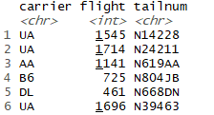
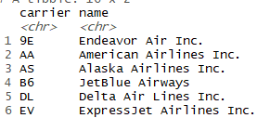
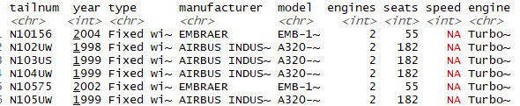
Flights dataset- nycflyights13::flights
carrier---Two letter carrier abbreviation. See airlines data set to get name.
flight----Flight number.
tailnum----Plane tail number. See planes data set for additional metadata.

Slide 5
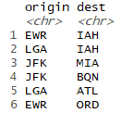
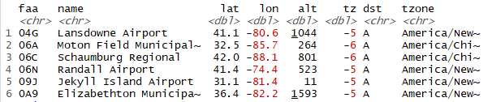
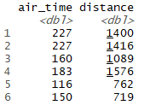
Flights dataset- nycflyights13::flights
origin, dest----Origin and destination. See airports data set for additional metadata.
air_time----Amount of time spent in the air, in minutes.
Distance----Distance between airports, in miles.

Slide 6
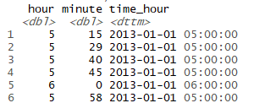
Flights dataset- nycflyights13::flights
hour, minute-----Time of scheduled departure broken into hour and minutes.
time_hour-----Scheduled date and hour of the flight

Slide 7
Types of variables
int stands for integers.
dbl stands for doubles, or real numbers.
chr stands for character vectors, or strings.
dttm stands for date-times (a date + a time).
lgl stands for logical, vectors that contain only TRUE or FALSE.
fctr stands for factors, which R uses to represent categorical variables with fixed possible values.
date stands for dates

Slide 8
dplyr Basics -Functions
Pick observations by their values (filter()).
Reorder the rows (arrange()).
Pick variables by their names (select()).
Create new variables with functions of existing variables (mutate()).
Collapse many values down to a single summary (summa rize()).
These can all be used in conjunction with group_by(), which changes the scope of each function from operating on the entire dataset to operating on it group-by-group.

Slide 9
dplyr Basics -Functions
The above six functions provide the verbs for a language of data manipulation
All verbs work similarly:
1. The first argument is a data frame.
2. The subsequent arguments describe what to do with the data frame, using the variable names (without quotes).
3. The result is a new data frame.

Slide 10
Sub Topic: Filter Rows with filter() Refer Video 1
filter() allows to subset observations based on their values.
The first argument is the name of the data frame.
The second and subsequent arguments are the expressions
For example, select all flights on January 1st with
jan1 <- filter(flights, month == 1, day == 1)
To save the result, use the assignment operator, <-:
Want to do save and print out the results, wrap the assignment in parentheses:
(dec25 <- filter(flights, month == 12, day == 25))

Slide 11
Comparisons Refer Video 1
To use filtering effectively, know how to select the observations using the comparison operators.
R provides the standard suite: >, >=, <=, != (not equal), and == (equal).
Use = instead of == when testing for equality.
filter(flights, month = 1)
#> Error: filter() takes unnamed arguments. Do you need `==`?

Slide 12
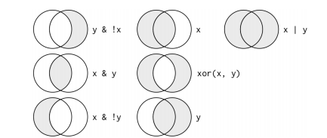
Logical Operators Refer Video 1
Use Boolean operators: & is “and,” | is “or,” and ! is “not.”
The following figure shows the complete set of Boolean operations

Slide 13
Few Examples Refer Video 1
1. Finds all flights that departed in November or December:
filter(flights, month == 11 | month == 12) (OR)
nov_dec <- filter(flights, month %in% c(11, 12))
Find flights that weren’t delayed (on arrival or departure) by more than two hours
filter(flights, !(arr_delay > 120 | dep_delay > 120)) (OR)
filter(flights, arr_delay <= 120, dep_delay <= 120)

Slide 14
Missing Values Refer Video 1
One important feature of R that can make comparison tricky is missing values, or NAs (“not availables”).
NA represents an unknown value , almost any operation involving an unknown value will also be unknown:
NA > 5 #> [1] NA
10 == NA #> [1] NA
NA + 10 #> [1] NA)
NA == NA #> [1] NA
Use is.na()to determine if a value is missing,
# Let x be Mary's age. We don't know how old she is. x <- NA
is.na(x) #> [1] TRUE

Slide 15
Filter Rows with filter() –Exercises Refer Video 2
1. Find all flights that:
a. Had an arrival delay of two or more hours
Since the arr_delay variable is measured in minutes, find flights with an arrival delay of 120 or more minutes.
filter(flights, arr_delay >= 120)
B. Flew to Houston (IAH or HOU)
The flights that flew to Houston are those flights where the destination (dest) is either “IAH” or “HOU”.
filter(flights, dest == "IAH" | dest == "HOU")
filter(flights, dest %in% c("IAH", "HOU"))

Slide 16
Filter Rows with filter() –Exercises Refer Video 2
C. Were operated by United, American, or Delta
We can find the carrier codes for the airlines in the airlines dataset.
Since the carrier code dataset only has 16 rows, and the names of the airlines in that dataset are not exactly “United”, “American”, or “Delta”
airlines
The carrier code for Delta is "DL", for American is "AA", and for United is "UA".
filter(flights, carrier %in% c("AA", "DL", "UA"))
D. Departed in summer (July, August, and September)
The variable month has the month, and it is numeric. So, the summer flights are those that departed in months 7 (July), 8 (August), and 9 (September)
filter(flights, month >= 7, month <= 9)
filter(flights, month %in% 7:9)

Slide 17
Filter Rows with filter() –Exercises Refer Video 2
E. Arrived more than two hours late, but didn’t leave late
Flights that arrived more than two hours late, but didn’t leave late will have an arrival delay of more than 120 minutes (arr_delay > 120) and a non-positive departure delay (dep_delay <= 0).
filter(flights, arr_delay > 120, dep_delay <= 0)
F. Were delayed by at least an hour, but made up over 30 minutes in flight
If a flight was delayed by at least an hour, then dep_delay >= 60. If the flight didn’t make up any time in the air, then its arrival would be delayed by the same amount as its departure, meaning dep_delay == arr_delay, or alternatively, dep_delay - arr_delay == 0
If it makes up over 30 minutes in the air, then the arrival delay must be at least 30 minutes less than the departure delay, which is stated as dep_delay - arr_delay > 30.
filter(flights, dep_delay >= 60, dep_delay - arr_delay > 30)

Slide 18
Filter Rows with filter() –Exercises Refer Video 2
G. Departed between midnight and 6 a.m. (inclusive)
filter(flights, dep_time <= 600 | dep_time == 2400)
2. Another useful dplyr filtering helper is between(). What does it do? Can you use it to simplify the code needed to answer the previous challenges?
The expression between(x, left, right) is equivalent to x >= left & x <= right
filter(flights, between(month, 7, 9))

Slide 19
Filter Rows with filter() –Exercises Refer Video 2
3. How many flights have a missing dep_time? What other variables are missing? What might these rows represent?
Find the rows of flights with a missing departure time (dep_time) using the is.na() function.
filter(flights, is.na(dep_time))
Notably, the arrival time (arr_time) is also missing for these rows. These seem to be cancelled flights

Slide 20
Filter Rows with filter() –Exercises Refer Video 2
4. Why is NA ^ 0 not missing? Why is NA | TRUE not missing? Why is FALSE & NA not missing? Can you figure out the general rule? (NA * 0 is a tricky counterexample!)
NA ^ 0 == 1 since for all numeric values x^0=11.
NA | TRUE is TRUE because the value of the missing TRUE or FALSE, x or TRUE is TRUE for all values of x.
Likewise, anything and FALSE is always FALSE.
Since x∗0=0 for all finite, numeric x, we might expect NA * 0 = 0

Slide 21
Sub Topic: Arrange rows with arrange()
It takes a data frame and a set of column names to order by.
If use more than one column name, each additional column will be used to break ties in the values of preceding columns
arrange(flights, year, month, day)
Use desc() to reorder by a column in descending order
arrange(flights, desc(arr_delay))
Missing values are always sorted at the end

Slide 22
Arrange rows with arrange()--Exercises
1. How could you use arrange() to sort all missing values to the start? (Hint: use is.na().)
The arrange() function puts NA values last.
arrange(flights, dep_time)
Using desc() does not change that.
arrange(flights, desc(dep_time))
arrange(flights, desc(is.na(dep_time)), dep_time)

Slide 23
Arrange rows with arrange()--Exercises
2. Sort flights to find the most delayed flights. Find the flights that left earliest.
Find the most delayed flights by sorting the table by departure delay, in descending order.
arrange(flights, desc(dep_delay))
Similarly, the earliest departing flight can be found by sorting dep_delay in ascending order.
arrange(flights, dep_delay)
3. Sort flights to find the fastest flights.
mph = distance / air_time * 60
head(arrange(flights, desc(mph)))

Slide 24
Arrange rows with arrange()--Exercises
4. Which flights traveled the longest? Which traveled the shortest?
To find the longest flight, sort the flights by the distance column in descending order.
arrange(flights, desc(distance))
To find the shortest flight, sort the flights by the distance in ascending order, which is the default sort order.
arrange(flights, distance)
The longest and shortest flights by can be found by sorting by the air_time column.
arrange(flights, desc(air_time))
arrange(flights, air_time)

Slide 25
Sub Topic :Select columns with select()
Narrowing the data set on the variables you’re actually interested in
Zoom in on a useful subset based on the names of the variables
select(flights, year, month, day) # Select columns by name
# Select all columns between year and day (inclusive)
select(flights, year:day)
Select all columns except those from year to day (inclusive)
select(flights, -(year:day))

Slide 26
Sub Topic :Select columns with select()
There are a number of helper functions can use within select():
starts_with("abc") matches names that begin with “abc”.
ends_with("xyz") matches names that end with “xyz”.
contains("ijk") matches names that contain “ijk”.
Matches("(.)\\1") selects variables that match a regular expression.
This one matches any variables that contain repeated characters.
num_range("x", 1:3) matches x1, x2, and x3.

Slide 27
Sub Topic :Select columns with select()
Use rename(), which is a variant of select() that keeps all the variables that aren’t explicitly mentioned:
rename(flights, tail_num = tailnum)
Another option is to use select() in conjunction with the every thing() function.
This is useful when move some variables to the start of the data frame
select(flights, time_hour, air_time, everything())

Slide 28
Select columns with select() --Exercises
1. Brainstorm as many ways as possible to select dep_time, dep_delay, arr_time, and arr_delay from flights.
These are a few ways to select columns.
Specify columns names as unquoted variable names.
select(flights, dep_time, dep_delay, arr_time, arr_delay)
Specify column names as strings.
select(flights, "dep_time", "dep_delay", "arr_time", "arr_delay")
Specify the column numbers of the variables.
select(flights, 4, 6, 7, 9)

Slide 29
Select columns with select() --Exercises
Specify the names of the variables with character vector and one_of().
select(flights, one_of(c("dep_time", "dep_delay", "arr_time", "arr_delay")))
Selecting the variables by matching the start of their names using starts_with().
select(flights, starts_with("dep_"), starts_with("arr_"))
Matching the ends of their names using ends_with() since this will incorrectly include other variables. For example,
select(flights, ends_with("time"), ends_with("delay"))
Matching the names using contains() since there is not a pattern that can include all these variables without incorrectly including others.
select(flights, contains("_time"), contains("arr_"))

Slide 30
Select columns with select() --Exercises
2. What happens if you include the name of a variable multiple times in a select() call?
The select() call ignores the duplication. Any duplicated variables are only included once, in the first location they appear. The select() function does not raise an error or warning or print any message if there are duplicated variables.
select(flights, year, month, day, year, year)

Slide 31
Select columns with select() --Exercises
3. What does the one_of() function do? Why might it be helpful in conjunction with this vector?
The one_of() function selects variables with a character vector rather than unquoted variable name arguments.
This function is useful because it is easier to programmatically generate character vectors with variable names than to generate unquoted variable names, which are easier to type.
vars <- c("year", "month", "day", "dep_delay", "arr_delay")
select(flights, one_of(vars))

Slide 32
Select columns with select() --Exercises
4. Does the result of running the following code surprise you? How do the select helpers deal with case by default? How can you change that default?
select(flights, contains("TIME"))
The default behavior for contains() is to ignore case
That match variable names case insensitive by default will make the behavior of select() consistent regardless of whether the table is stored as an R data frame or in a database
To change the behavior add the argument ignore.case = FALSE.
select(flights, contains("TIME", ignore.case = FALSE))

Slide 33
Sub topic: Add new variables with mutate() Refer Video 3
To add new columns that are functions of existing columns
mutate() always adds new columns at the end of dataset
create a narrower dataset to see the new variables.
flights_sml <- select(flights, year:day, ends_with("delay"), distance, air_time )
mutate(flights_sml, gain = arr_delay - dep_delay, speed = distance / air_time * 60)
Refer the columns that just created
mutate(flights_sml, gain = arr_delay - dep_delay, hours = air_time / 60, gain_per_hour = gain / hours )

Slide 34
Sub topic: Add new variables with mutate() Refer Video 3
To keep the new variables, use transmute()
transmute(flights, gain = arr_delay - dep_delay, hours = air_time / 60, gain_per_hour = gain / hours )
When create new variables can use:
Arithmetic operators +, -, *, /, ^
Modular arithmetic (%/% and %%)--%/% (integer division) and %% (remainder)
For example, in the flights dataset, compute hour and minute from dep_time with:
transmute(flights, dep_time, hour = dep_time %/% 100, minute = dep_time %% 100 )

Slide 35
Add new variables with mutate() Exercises Refer Video 3
1. Currently dep_time and sched_dep_time are convenient to look at, but hard to compute with because they’re not really continuous numbers. Convert them to a more convenient representation of number of minutes since midnight.
1504 %/% 100 [1] 15 // Separate hours
1504 %% 100 [1] 4 // Separate Minutes
1504 %/% 100 * 60 + 1504 %% 100 //Convert into total minutes
904 // Total minutes
904%% 1440 // Since midnight ,,,1440 Total minutes for midnight

Slide 36
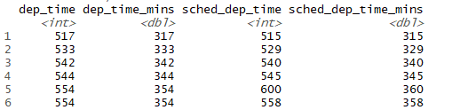
Add new variables with mutate() Exercises Refer Video 3
flights_times <- mutate(flights, dep_time_mins = (dep_time %/% 100 * 60 + dep_time %% 100) %% 1440, sched_dep_time_mins = (sched_dep_time %/% 100 * 60 + sched_dep_time %% 100) %% 1440 )
select( flights_times, dep_time, dep_time_mins, sched_dep_time, sched_dep_time_mins )

Slide 37
Add new variables with mutate() Exercises Refer Video 3
2. Compare air_time with arr_time - dep_time. What do you expect to see? What do you see? What do you need to do to fix it?
air_time is the difference between the arrival (arr_time) and departure times (dep_time). In other words, air_time = arr_time - dep_time.
First need to convert the times to a form more convenient to arithmetic operations
flights_airtime <- mutate(flights, dep_time = (dep_time %/% 100 * 60 + dep_time %% 100) %% 1440, arr_time = (arr_time %/% 100 * 60 + arr_time %% 100) %% 1440, air_time_diff = arr_time - dep_time )
head(flights_airtime$air_time_diff ) ; head(flights$air_time)
But the calculated air_time and the values under column air_time are not equal because of 2 reasons
1.The flight may passes midnight, so arr_time < dep_time. In these cases, the difference in airtime should be by 24 hours (1,440 minutes).
2. The flight crosses time zones, and the total air time will be off by hours

Slide 38
Add new variables with mutate() Exercises Refer Video 3
3. Compare dep_time, sched_dep_time, and dep_delay. How would you expect those three numbers to be related?
The departure delay (dep_delay) to be equal to the difference between scheduled departure time (sched_dep_time), and actual departure time (dep_time), dep_time - sched_dep_time = dep_delay.
flights_deptime <- mutate(flights, dep_time_min = (dep_time %/% 100 * 60 + dep_time %% 100) %% 1440, sched_dep_time_min = (sched_dep_time %/% 100 * 60 + sched_dep_time %% 100) %% 1440, dep_delay_diff = dep_time_min - sched_dep_time_min )
head(flights_deptime$dep_delay_diff); head(flights$dep_delay)
Does dep_delay_diff equal zero dept_delay for all rows? No
Because a flight was scheduled to depart before midnight, but was delayed after midnight.

Slide 39
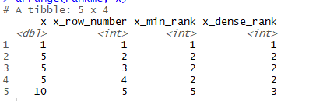
Add new variables with mutate() Exercises Refer Video 3
4. Find the 10 most delayed flights using a ranking function. How do you want to handle ties? Carefully read the documentation for min_rank()
The dplyr package provides multiple functions for ranking, which differ in how they handle tied values row_number(), min_rank() dense_rank().
For example :
rankme <- tibble( x = c(10, 5, 1, 5, 5) )
rankme <- mutate(rankme, x_row_number = row_number(x), x_min_rank = min_rank(x), x_dense_rank = dense_rank(x) )
arrange(rankme, x)

Slide 40
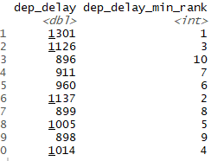
Add new variables with mutate() Exercises Refer Video 3
flights_delayed <- mutate(flights, dep_delay_min_rank = min_rank(desc(dep_delay)))
flights_delayed <- filter( flights_delayed, !(dep_delay_min_rank > 10 ))
select(flights_delayed, dep_delay,dep_delay_min_rank)

Slide 41
Add new variables with mutate() Exercises Refer Video 3
5. What does 1:3 + 1:10 return? Why?
The code given in the question returns the following.
1:3 + 1:10
#> Warning in 1:3 + 1:10:
longer object length is not a multiple of shorter #> object length #>
[1] 2 4 6 5 7 9 8 10 12 11
This is equivalent to the following.
c(1 + 1, 2 + 2, 3 + 3, 1 + 4, 2 + 5, 3 + 6, 1 + 7, 2 + 8, 3 + 9, 1 + 10)
#> [1] 2 4 6 5 7 9 8 10 12 11

Slide 42
Add new variables with mutate() Exercises Refer Video 3
6. What trigonometric functions does R provide?
All trigonometric functions are all described in a single help page, named Trig.
R provides functions for the three primary trigonometric functions: sine (sin())), cosine (cos()), and tangent (tan()).
The input angles to all these functions are in radians.

Slide 43
Sub Topic: Grouped Summaries with summarize()
It collapses a data frame to a single row
summarize(flights, delay = mean(dep_delay, na.rm = TRUE))
12.6
summarize() is not very useful with out group_by()
by_day <- group_by(flights, year, month, day)
summarize(by_day, delay = mean(dep_delay, na.rm = TRUE))

Slide 44
Combining Multiple Operations with the Pipe
To explore the relationship between the distance and average delay for each location.
by_dest <- group_by(flights, dest)
delay <- summarize(by_dest, count = n(), dist = mean(distance, na.rm = TRUE), delay = mean(arr_delay, na.rm = TRUE) )
delay <- filter(delay, count > 20, dest != "HNL")
There are three steps to prepare this data:
1. Group flights by destination.
2. Summarize to compute distance, average delay, and number of flights.
3. Filter to remove noisy points and Honolulu airport, which is almost twice as far away as the next closest airport.

Slide 45
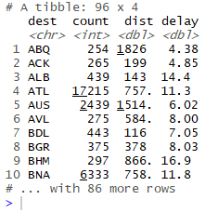
Combining Multiple Operations with the Pipe
The above code is complicated to write because give each intermediate data frame a name, so this slows down analysis.
delays <- flights %>% group_by(dest) %>% summarize( count = n(), dist = mean(distance, na.rm = TRUE), delay = mean(arr_delay, na.rm = TRUE) ) %>% filter(count > 20, dest != "HNL")
If na.rm is missing, then the result
will be missing value as per the rule

Slide 46
Grouping by Multiple Variables
When you group by multiple variables, each summary peels off one level of the grouping. That makes it easy to progressively roll up a dataset
daily <- group_by(flights, year, month, day)
per_day <- summarize(daily, flights = n())
per_month <- summarize(per_day, flights = sum(flights))
per_year <- summarize(per_month, flights = sum(flights))
it’s OK for sums and counts, but need to think about calculating means and variances
In other words, the sum of groupwise sums is the overall sum, but the median of groupwise medians is not the overall median.

Slide 47
Ungrouping
To remove grouping, and return to operations on ungrouped data, use ungroup()
daily %>% ungroup() %>% # no longer grouped by date
summarize(flights = n()) # all flights

Slide 48
Grouped Summaries with summarize()--Exercises
1. Brainstorm at least five different ways to assess the typical delay characteristics of a group of flights. Consider the following scenarios:
A flight is 15 minutes early 50% of the time, and 15 minutes late 50% of the time.
A flight is always 10 minutes late.
A flight is 30 minutes early 50% of the time, and 30 minutes late 50% of the time.
99% of the time a flight is on time. 1% of the time it’s 2 hours late.
Which is more important: arrival delay or departure delay?

Slide 49
Grouped Summaries with summarize()--Exercises
In many scenarios, arrival delay is more important.
In most cases, being arriving late is more costly to the passenger since it could disrupt the next stages of their travel, such as connecting flights or scheduled meetings.
If a departure is delayed without affecting the arrival time, this delay will not affects plans .

Slide 50
Grouped Summaries with summarize()--Exercises
2. Come up with another approach that will give you the same output as
i.not_cancelled %>% count(dest) and
ii.not_cancel led %>% count(tailnum, wt = distance)
(without using count())
Answer: Given not_cancelled
not_cancelled <- flights %>% filter(!is.na(dep_delay), !is.na(arr_delay))
i. Instead of using the count() function, combine the group_by() and summarise()
not_cancelled %>% group_by(dest) %>% summarise(n = n())
ii. Wt is weighting variable
not_cancelled %>% group_by(tailnum) %>% summarise(n = sum(distance))

Slide 51
Grouped Summaries with summarize()--Exercises
3. Our definition of cancelled flights (is.na(dep_delay) | is.na(arr_delay) ) is slightly suboptimal. Why? Which is the most important column?
If the dep_delay is NULL then the flights are cancelled without any doubts.
But arr_delay is NULL then a flight may crashes, or if it is redirected and lands in an airport other than its specified destination.
So the arr_delay column remains NULL for all diverted flights.

Slide 52
Grouped Summaries with summarize()--Exercises
4. Look at the number of cancelled flights per day. Is there a pattern? Is the proportion of cancelled flights related to the average delay?
cancelled_per_day <- flights %>% mutate(cancelled = (is.na(arr_delay) | is.na(dep_delay))) %>%
group_by(year, month, day) %>%
summarise( cancelled_num = sum(cancelled), flights_num = n() )
Plotting flights_num against cancelled_num shows that the number of flights cancelled increases with the total number of flights.
ggplot(cancelled_per_day) +
geom_point(aes(x = flights_num, y = cancelled_num))

Slide 53
Grouped Summaries with summarize()--Exercises
cancelled_and_delays <- flights %>%
mutate(cancelled = (is.na(arr_delay) | is.na(dep_delay))) %>%
group_by(year, month, day) %>%
summarise( cancelled_prop = mean(cancelled),
avg_dep_delay = mean(dep_delay, na.rm = TRUE),
avg_arr_delay = mean(arr_delay, na.rm = TRUE) )
ggplot(cancelled_and_delays) +
geom_point(aes(x = avg_dep_delay, y = cancelled_prop))
ggplot(cancelled_and_delays) +
geom_point(aes(x = avg_arr_delay, y = cancelled_prop))
There is a strong increasing relationship between both average departure delay and and average arrival delay and the proportion of cancelled flights.

Slide 54
Sub Topic: Grouped Mutates (and Filters)
Grouping is most useful in conjunction with summarize(), but also do convenient operations with mutate() and filter()
Find all groups bigger than a threshold:
flights_sml <- select(flights, year:day, dest, distance, air_time )
head(flights_sml %>%
group_by(dest) %>%
filter(n() > 365))

Slide 55
Grouped Mutates (and Filters)-Exercises
1. Refer back to the table of useful mutate and filtering functions. Describe how each operation changes when you combine it with grouping.
Summary functions (mean()), ranking functions (min_rank(), row_number()), operate within each group when used with group_by() in mutate() or filter().
Arithmetic operators (+, -), logical operators (<, ==), modular arithmetic operators (%%, %/%) are not affected by group_by.

Slide 56
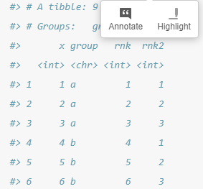
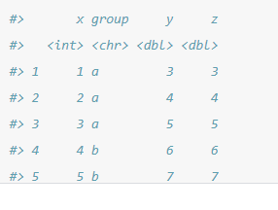
Grouped Mutates (and Filters)-Exercises
tibble(x = 1:9, group = rep(c("a", "b", "c"), each = 3)) %>% mutate(rnk = min_rank(x)) %>% group_by(group) %>% mutate(rnk2 = min_rank(x))
tibble(x = 1:9, group = rep(c("a", "b", "c"), each = 3)) %>% mutate(y = x + 2) %>% group_by(group) %>% mutate(z = x + 2)

Slide 57
Grouped Mutates (and Filters)-Exercises
2. What time of day should you fly if you want to avoid delays as much as possible?
The flight which scheduled earlier , its expected delay become low. This is because earlier flight’s delays will affect later flights. So group by an hour to know the earlier flights.
flights %>% group_by(hour) %>%
summarise(arr_delay = mean(arr_delay, na.rm = TRUE)) %>%
arrange(arr_delay)

Slide 58
Grouped Mutates (and Filters)-Exercises
3. For each destination, compute the total minutes of delay. For each flight, compute the proportion of the total delay for its destination.
flights %>% filter(arr_delay > 0) %>% group_by(dest) %>%
mutate( arr_delay_total = sum(arr_delay), arr_delay_prop = arr_delay / arr_delay_total ) %>%
select(dest, month, day, dep_time, carrier, flight, arr_delay, arr_delay_prop) %>% arrange(dest, desc(arr_delay_prop))

Slide 59
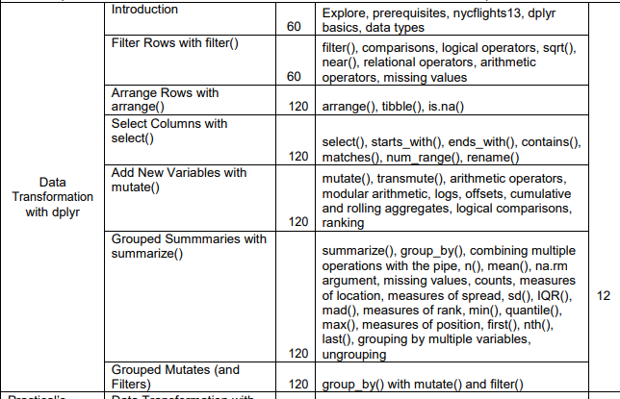
Unit II Summary

